Slide 1

Strategic Marketing Locations to Convert Casual Riders into Member

Slide 2
Problem
Identifying common behavior between casual and member riders
Solution
Help marketing campaign team maximize their chances to convert casual riders into member riders

Slide 3
Analytical Goals
HOW: Identify the behaviour of casual riders and member riders
WHERE: Potential places where casual riders will most likely to convert to member riders

Slide 4
HOW
Identify the behaviour of casual riders and member riders

Slide 5
RIDER’S BEHAVIOUR
Duration of rides
Difference between the time started and the time ended for riding
Distance travelled
Difference of point on earth from latitude and longitude between starting and ending stations

Slide 6
DURATION STATISTICS
 | Casual Rider | Member Rider
Count | 32 Minutes | 13 Minutes
Mean | 32 Minutes | 13 Minutes
Max | 38 Days, 20 Hours, 24 Minutes | 1 Day, 55 Minutes
Standard Deviation | 4 Hours, 34 Minutes | 17 Minutes

Slide 7
DISTANCE STATISTICS
 | Casual Rider | Member Rider
Mean | 2.17 Kilometers | 2.07 Kilometers
Max | 1192.24 Kilometers | 31.53 Kilometers
Min | 0.00 Kilometers | 0.00 Kilometers
Standard Deviation | 2.14 Kilometers | 1.78 Kilometers

Slide 8
Casual riders tend to ride longer and farther than member riders. So our focus should be on the casual riders that behave almost similarly with average member riders when using our ride service.

Slide 9
Potential places where casual riders will most likely to convert to member riders
WHERE

Slide 10
Types of comparison
Direct comparison
Behavioural comparison
Duration
Distance

Slide 11
Filter Formula
Duration
(0, member average duration + member std duration)
Distance
(member average distance – member std distance,
member average distance + member std distance)

Slide 12
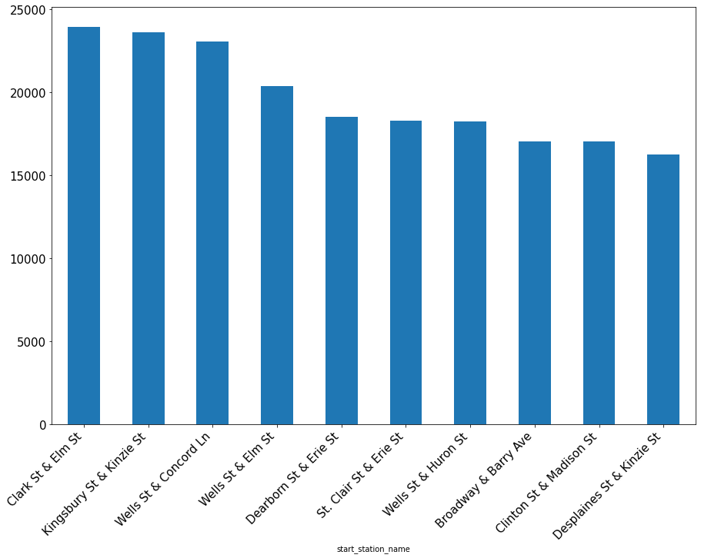
Member Riders’ Top 10 Most Common Starting Places
Clark St & Elm St: 23961,
Kingsbury St & Kinzie St: 23629,
Wells St & Concord Ln: 23051,
Wells St & Elm St: 20394,
Dearborn St & Erie St: 18518,
St. Clair St & Erie St: 18321,
Wells St & Huron St: 18250,
Broadway & Barry Ave: 17060,
Clinton St & Madison St: 17041,
Desplaines St & Kinzie St: 16262

Slide 13
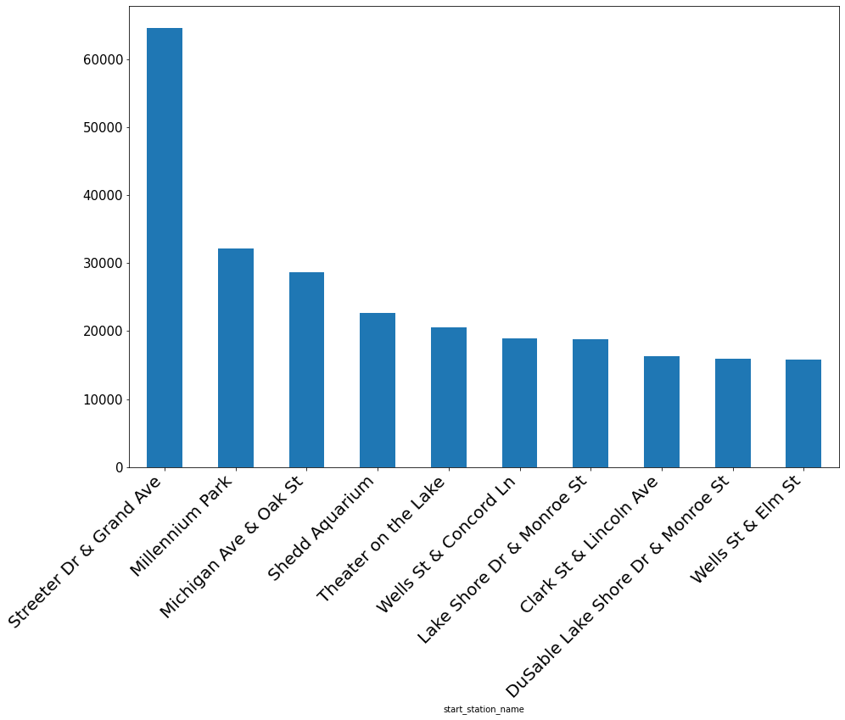
Casual Member’s Top 10 Most Common Starting Places
Streeter Dr & Grand Ave: 64586,
Millennium Park: 32171,
Michigan Ave & Oak St: 28650,
Shedd Aquarium: 22613,
Theater on the Lake: 20565,
Wells St & Concord Ln: 18917,
Lake Shore Dr & Monroe St: 18789,
Clark St & Lincoln Ave: 16250,
DuSable Lake Shore Dr & Monroe St: 15935,
Wells St & Elm St: 15830

Slide 14
Wells St & Concord Ln station and Wells St & Elm St station appeared in both categories. We could convert the most casual riders to member riders within these stations.
Note: Top 10 most common starting places for member riders might be places filled with people who have more than average incomes. Also, we can use above findings to compare our data in behavioural analysis.

Slide 15
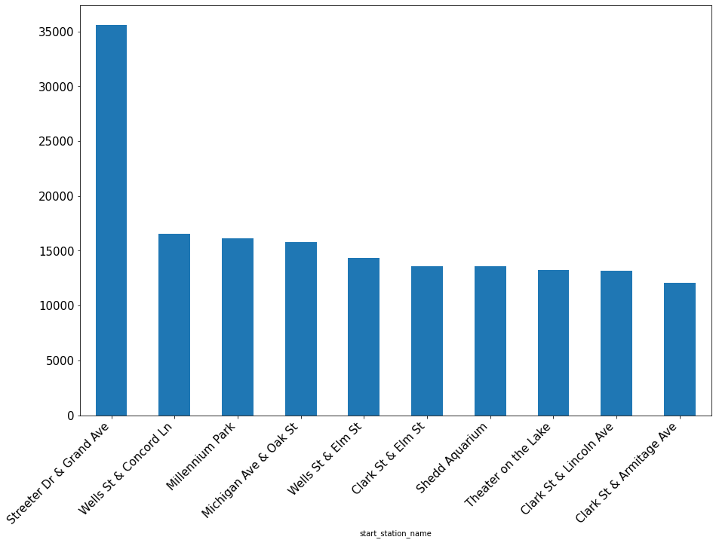
Casual Member with Similar Ride Duration with Average Member Riders
Streeter Dr & Grand Ave: 35608,
Wells St & Concord Ln: 16569,
Millennium Park: 16129,
Michigan Ave & Oak St: 15802,
Wells St & Elm St: 14358,
Clark St & Elm St: 13584,
Shedd Aquarium: 13556,
Theater on the Lake: 13220,
Clark St & Lincoln Ave: 13168,
Clark St & Armitage Ave: 12100

Slide 16
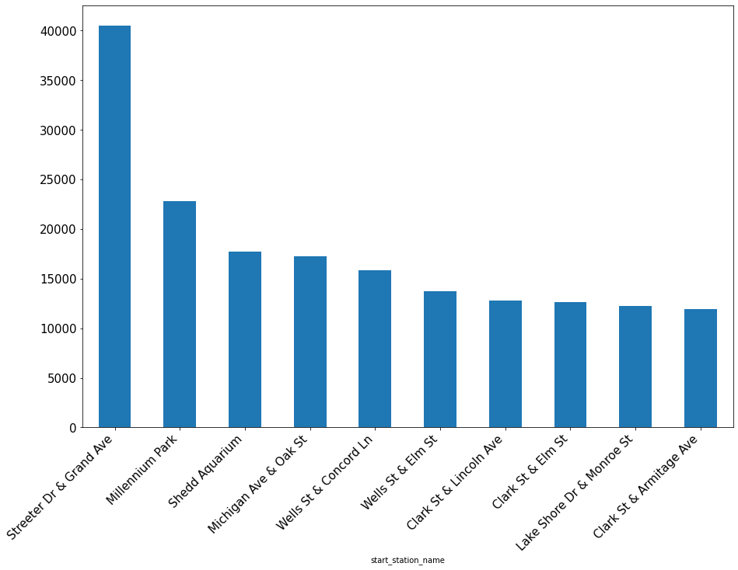
Casual Member with Similar Ride Distance with Average Member Riders
Streeter Dr & Grand Ave: 40528,
Millennium Park: 22826,
Shedd Aquarium: 17745,
Michigan Ave & Oak St: 17240,
Wells St & Concord Ln: 15826,
Wells St & Elm St: 13769,
Clark St & Lincoln Ave: 12825,
Clark St & Elm St: 12598,
Lake Shore Dr & Monroe St: 12207,
Clark St & Armitage Ave: 11955

Slide 17
Wells St & Concord Ln station, Wells St & Elm St station, and Clark St & Elm St station appeared in both type of filters. We could convert the most casual riders to member riders within these stations.
Clark St & Elm St station ranked 1st in Top 10 Member Riders’ Top Starting Stations

Slide 18
Why not places like Streeter Dr & Grand Ave and Millennium Park (high-ranked in filtered and non-filtered ranking) for our marketing targets?
Both of those places didn’t appear at Top 10 Member Riders’ Starting Stations.

Slide 19
Potential Locations
Clark St & Elm St
Wells St & Concord Ln
Wells St & Elm St

Slide 20
SUMMARY
HOW
Casual & Member riders behave differently in how long the duration and distance of rides they are using. Casual riders ride longer and farther.
WHERE
Clark St & Elm St
Wells St & Concord Ln
Wells St & Elm St

Slide 21
KEEP IN MIND!
Casual riders are already aware of the Cyclistic program and have chosen Cyclistic for their mobility needs
The marketing strategy needs to be massively different compared to marketing towards non-customer people.

Slide 22
Future Exploration & Analysis
Gather additional data about altitude of available stations.
Identify whether the difference in altitude between starting and ending stations will determine whether casual riders may want to convert to become member riders.
Check whether certain stations whose average casual riders behave almost similarly with average member riders are on the rise/fall of number of riders based on monthly trend
Further analyze the data and find out in what time range (in a day) is the most effective to do advertisement

Slide 23
THANK YOU

